Slide 1

Data Visualization
Data Visualization: Presentation 1
Oghenemano Utomudo Omogha

Slide 2
Data Visualization
Dataset 1 description:
Domain: GDP per capita all countries from 1999 – 2022
Data Size : 30 kb
Source : https://data.un.org/ or https://datatopics.worldbank.org/world-development-indicators/

Slide 3
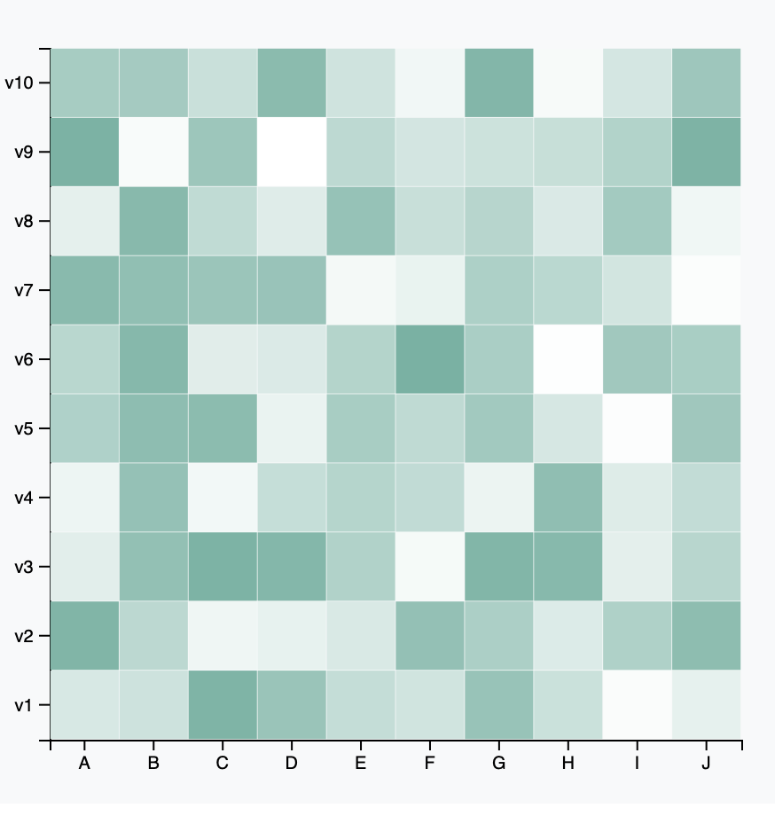
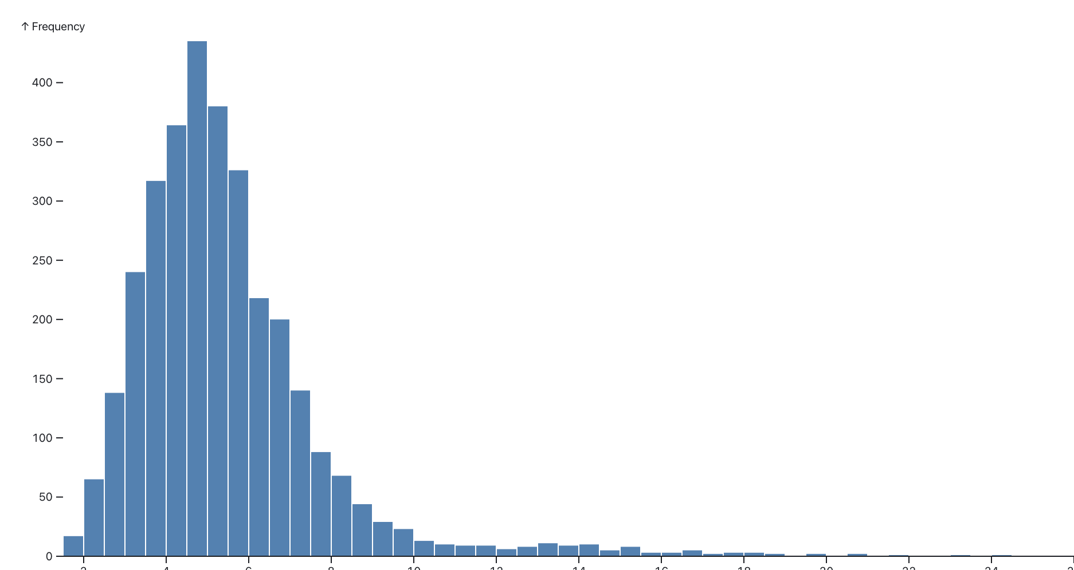
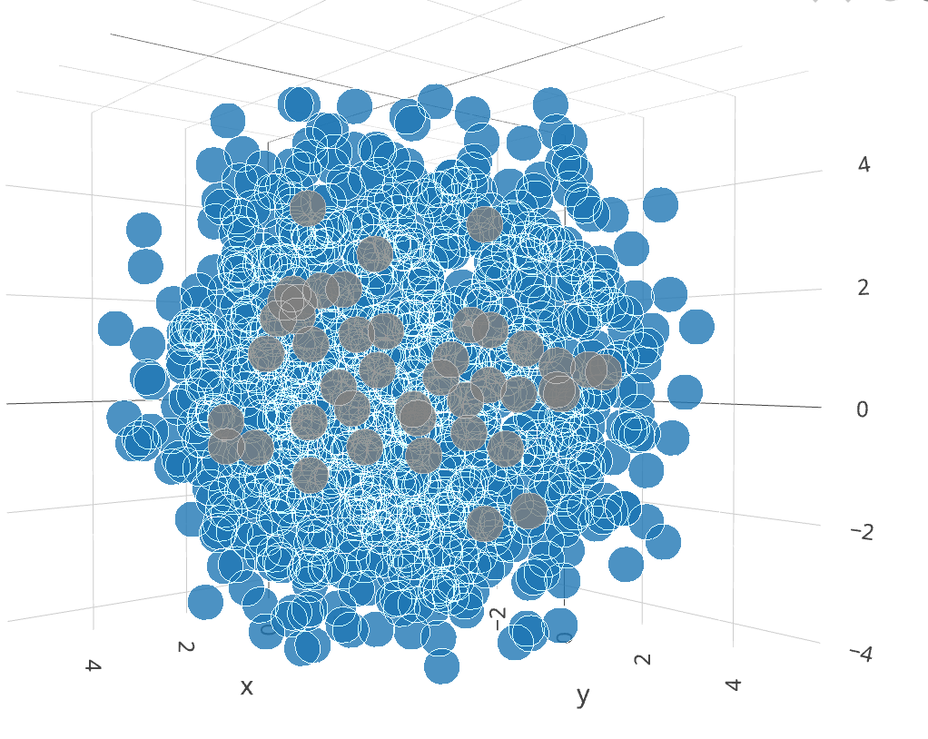
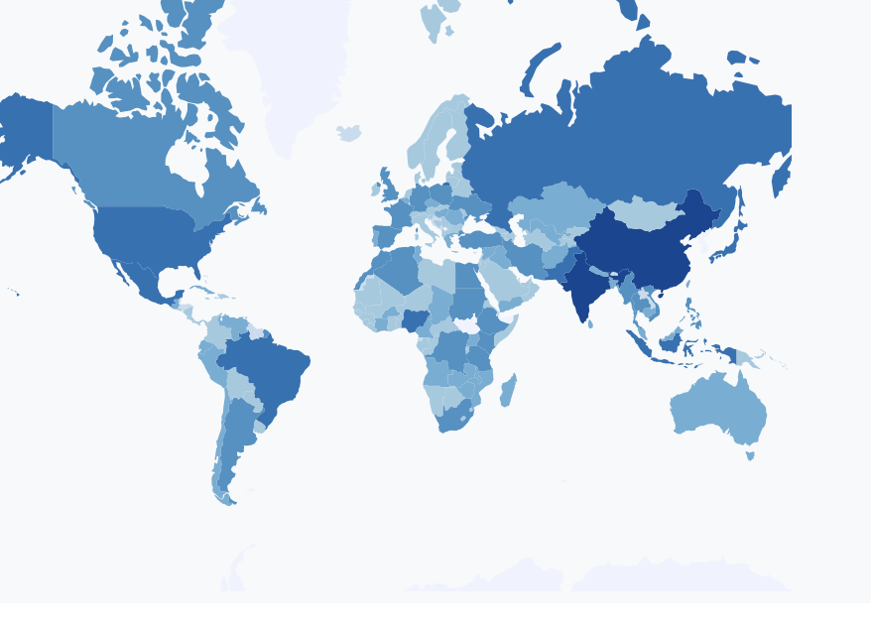
Data Visualization
Dashboard Visualization Techniques:
3d scatter plot
Heat map
Histogram plot
All graphic will be integrated with d3.js framework
Source: https://d3-graph-gallery.com/
Example :
d3.geoPath(); d3.geoMercator()
Choropleth Maps for Geographic Insights

Slide 4
Data Visualization
Dashboard Visualization Techniques:
Heatmaps for Correlation Analysis: Visualize pairwise correlations between numerical attributes to identify key factors impacting GDP performance.
Histograms and Box Plots: Display distributions of key attributes like countries and years
3D Scatter Plots for Complex Relationships: Visualize interactions between key attributes in a 3D space for deeper insights.
Choropleth Maps for Geographic Insights: Show regional variations in country gpd using color-coded maps based on location data.
Interactions
Filtering Interactions
Map Interactivity
Brushing and Linking
Tooltips

Slide 5
Data Visualization
Reasoning Behind Visualizations and Interactions:
Visualizations' Purpose and Complexity: Explain how advanced visualizations enable deeper exploration of complex data structures and relationships.
Importance of Interactivity for Exploring Multidimensional Data: Discuss how interactive features empower users to uncover hidden insights and patterns.
Implementation & Insights:
Special Arrangements of Charts for Multivariate Views: Design layouts to accommodate multiple sophisticated visualizations for comprehensive data analysis.
Implementation Details (Advanced Libraries & Tools): Utilize powerful visualization libraries like D3.js for rendering complex charts and interactive dashboards.
Statistical Analysis Techniques for Insightful Visualizations: Apply advanced statistical methods (e.g., clustering, dimensionality reduction) to preprocess data and derive meaningful visual representations.
Advanced Transitions/Animations for Enhanced User Experience: Incorporate dynamic transitions and animations to enhance usability and engagement

